Slide 1
IMAGE PROCESSING Emotion detection
Data science tools’ final project

Slide 2
Table of contents
01
02
03
04
Importing packages and preparing the data
Filtering the data and Scall it
Importing packages that we need in this project
Filter dodgy data and normalize the Residuals
Machine learning model
Classification
Making CNN model with the given data
Clustering data into two clusters : Happy and Sad

Slide 3
01
Importing packages
The most important packages for our project are Tensorflow and ComputerVision

Slide 4
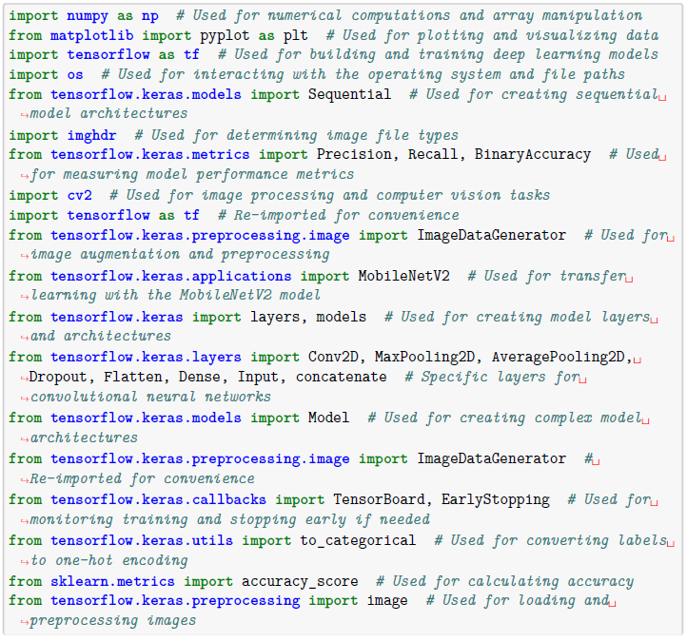

Slide 5
Purpose statement
What about Tensorflow ?
TensorFlow is primarily used for creating and training machine learning models, especially in the field of deep learning. It offers various high-level APIs like Keras for building neural networks and lower-level APIs for more customization that we used it already.
What about Cv2?
is a popular open-source computer vision and image processing library. It offers a comprehensive set of tools and functions for real-time computer vision applications. OpenCV provides a wide range of functionalities, including: Image Processing, Feature Detection and Description, Object Detection and Recognition, Machine Learning and Computer Vision
What about Matplotlib?
Matplotlib is a powerful and widely-used plotting library in Python that provides a range of functionalities for creating visualizations.

Slide 6
02
Filtering the data and Scall it
Filter data that don't have given extensions, like :
['jpeg', 'jpg', 'bmp', 'png’]. And scall our data

Slide 7
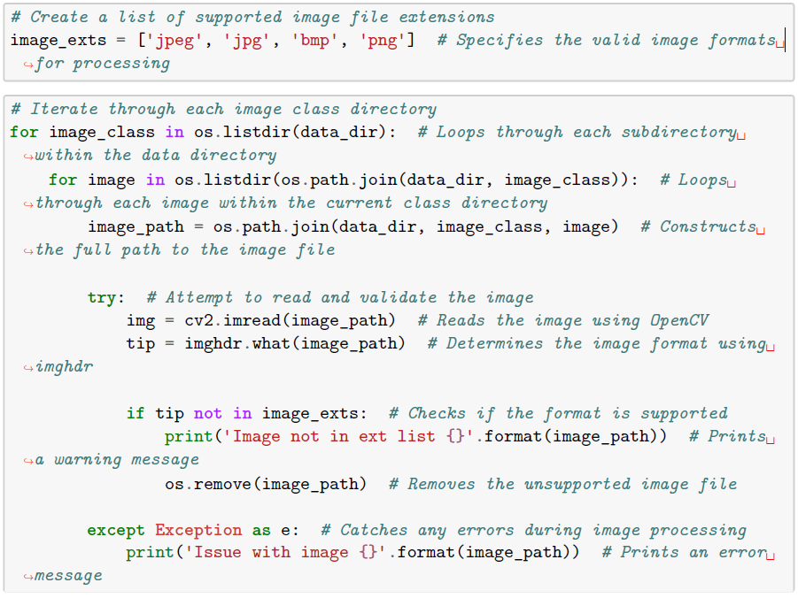

01
Filtering
Filtering dodgy data by looping on it and delete the data we don’t want it, like this code:
02
Scalling
Normalizing and Scaling the data to ease handling it and know how to make processes on it.

Slide 8
Machine learning model
03

Slide 9
Sub-topics
Splitting the data
Models
Splitting the data into three sets to add it to our model
Build Deep Learning Models
And use the three sets :
Training - Validation - Testing
Choosing optimizer
Sammary
Choose the best optimizer to our model. In our case we chose Adam optimizer
Sammarize the model by layers

Slide 10
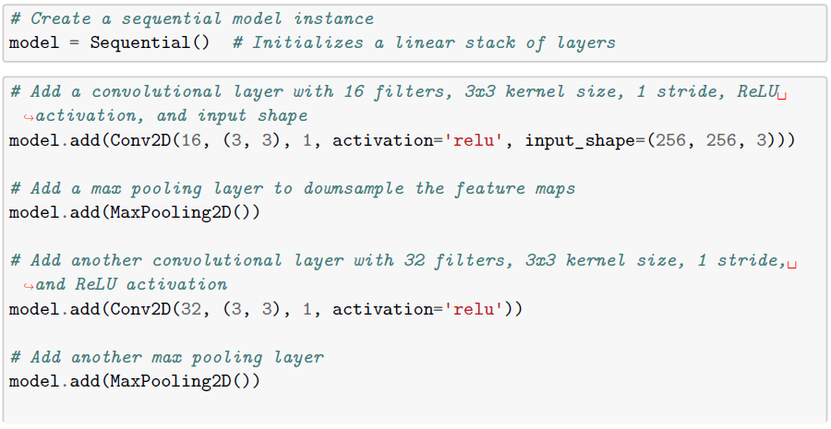
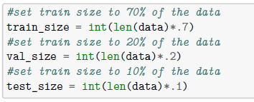
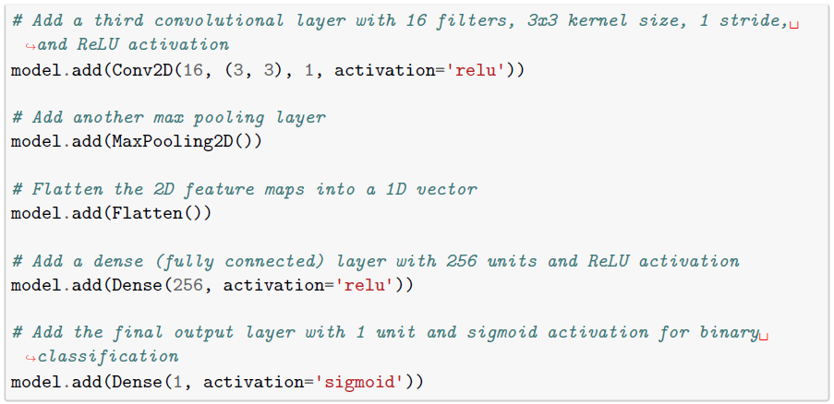
Detailed by code
Splitting the data
CNN

Slide 11
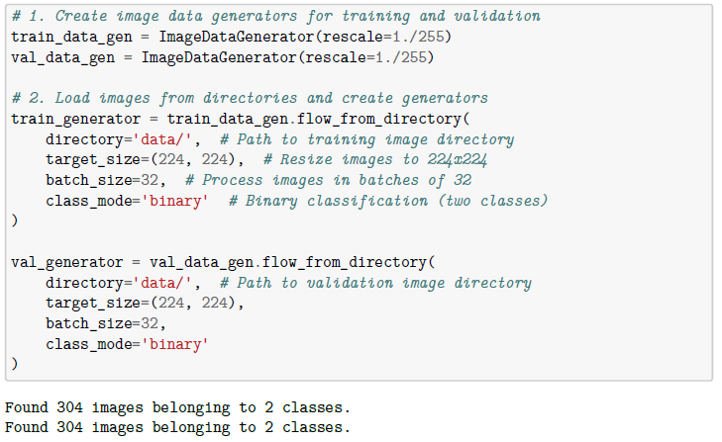
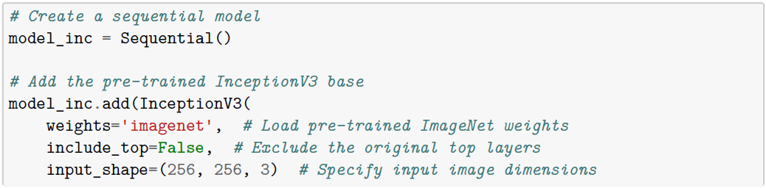
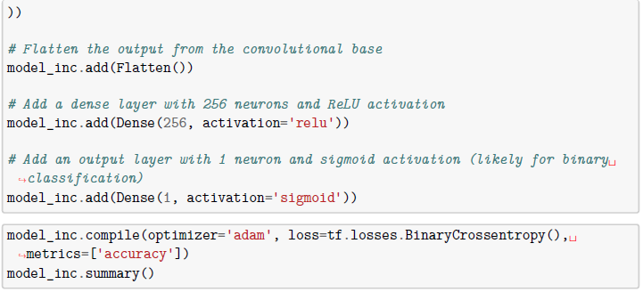
Detailed by code
Mobile net
Inception

Slide 12
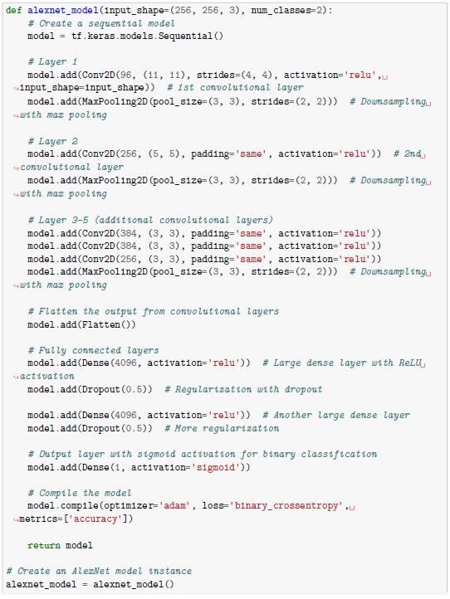
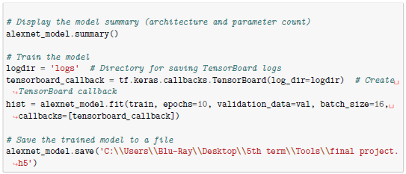
Detailed by code
Alex net

Slide 13

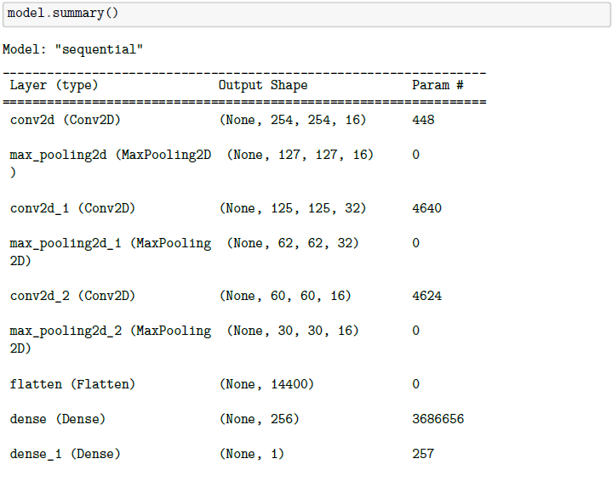
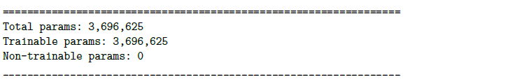
Detailed by code
Choosing optimizer
Sammary

Slide 14
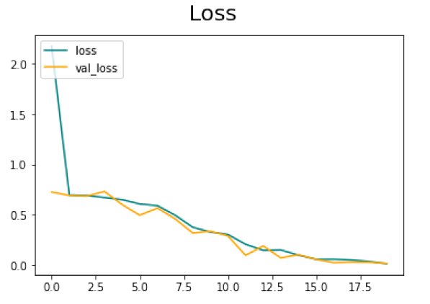
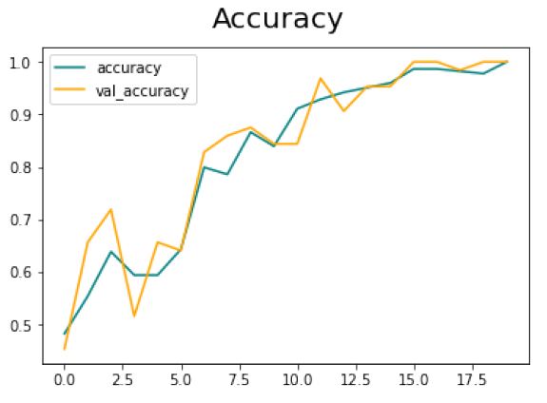
Plots about our model
Loss
Accuracy

Slide 15

Validation
04
validate data with picture out of train

Slide 16
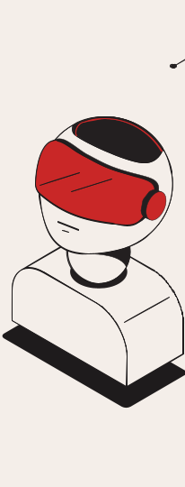

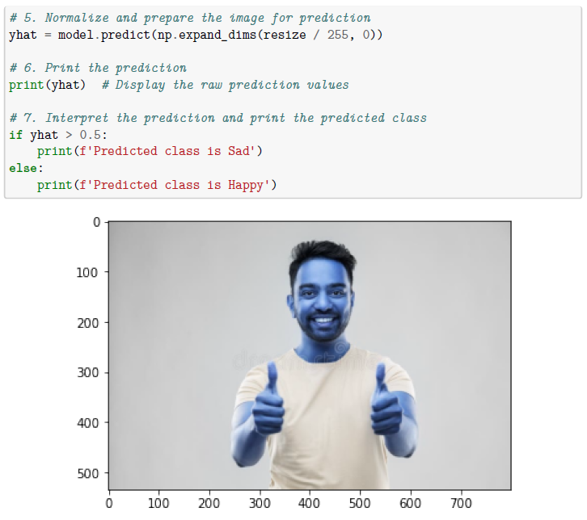
Detailed by code
And the model decide if it’s happy or sad class

Slide 17
Thank you

